Slide 1
Body Support Problem

Slide 2
Problem Description
Experimental setup: Set hardbound in x and y at the initial position, and only allow Z-motion
Observation:
Arm constantly shaking (joint 5 motor large noise) when moved to a certain position in task space.
All joints constantly drifting (constantly increasing or decreasing, not variation)
We wait 3 minutes, the BS has completely shifted orientation and position
Initial guess: two problems are coupled: the shaking causes the drift

Slide 3
Potential Cause for Shaking (in beginning)
Hardware issue (the vibration is something we do not command the arm to do)
Motor/ Arm damaged
The speed when hits the bound is too high.
Software Issue: (the vibration happens because we let the arm to do like that)
Unstable control frequency at 500Hz
Force Sensor issue: reading vibrated forces which causes vibrational motion on the arm
Wrong reference trajectory being generated (GTFO issue)
GTFO hardbound issue (Did not cancel out the speed and position entirely)

Slide 4
Potential Cause for Shaking: Hardware
Hardware issue (the vibration is something we do not command the arm to do)
Motor/ Arm damaged
The speed when hits the bound is too high.
Almost the first one to exclude: Everything works fine in teach mode, so the hardware itself is OK

Slide 5
Potential Cause for Shaking: Hardware
Hardware issue (the vibration is something we do not command the arm to do)
Motor/ Arm damaged
The speed when hits the bound is too high.
Excluded: The vibration for hitting the lower bound is very tiny (with nearly same speed), and no large noise on motors

Slide 6
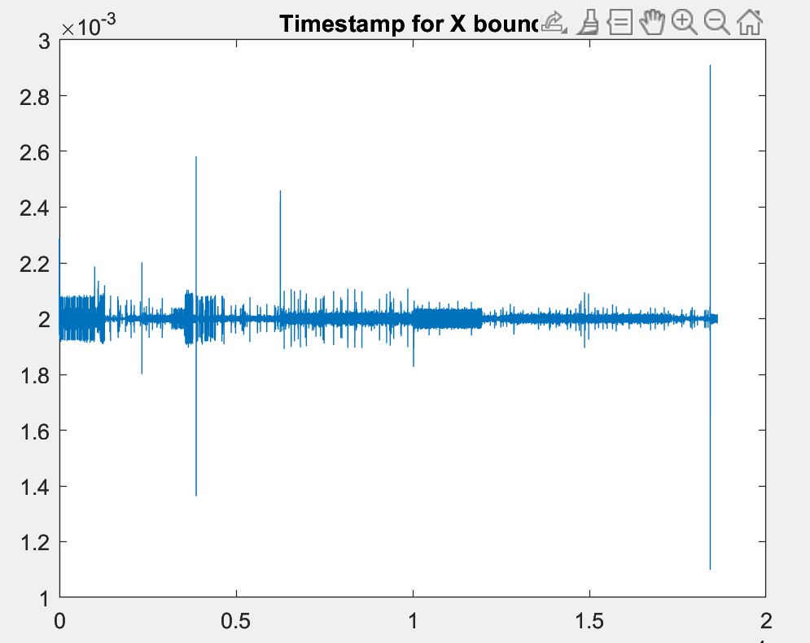
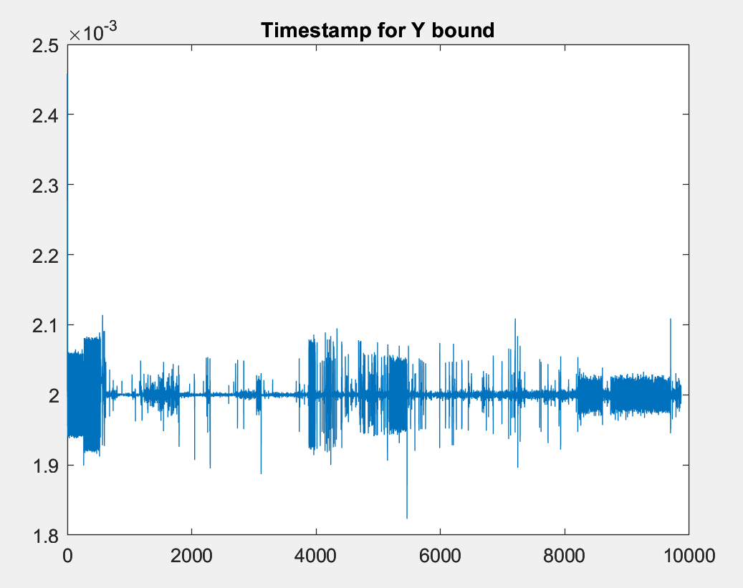
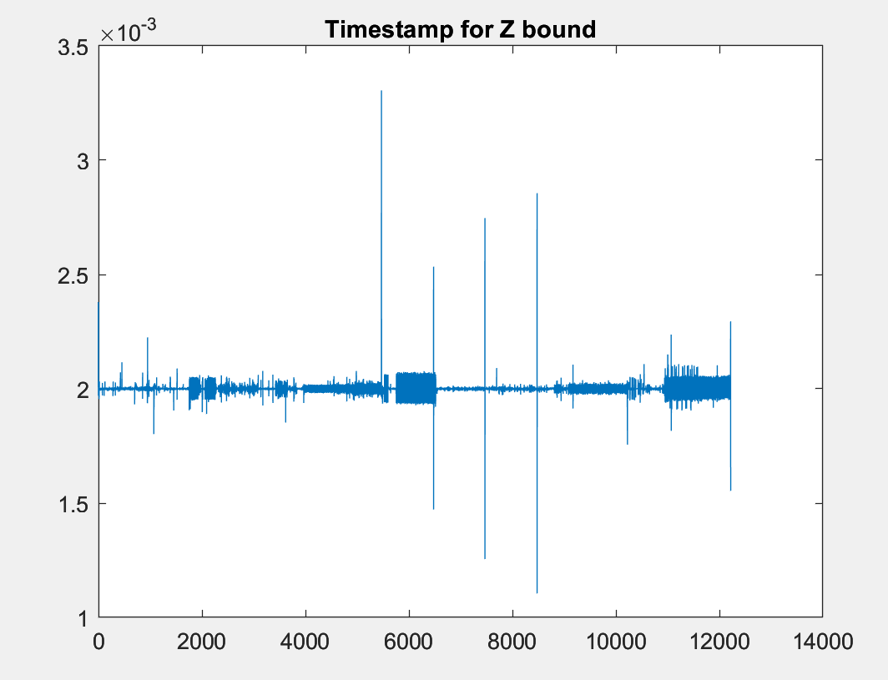
Potential Cause for Shaking: Software
Software Issue: (the vibration happens because we let the arm to do like that)
Unstable control frequency at 500Hz Excluded
Test setup: instead of Z bounds, set X and Y bounds and see their timestamp:
Shaking did not happen on both directions for X and Y (+X +Y -X -Y).

Slide 7
Potential Cause for Shaking: Software
Software Issue: (the vibration happens because we let the arm to do like that)
Unstable control frequency at 500Hz
Force Sensor issue: reading vibrated forces which causes vibrational motion on the arm
Assumption:
When it hits the bound -> Vibration starts -> force sensor feels the vibration and reads forces -> command the robot to move accordingly

Slide 8
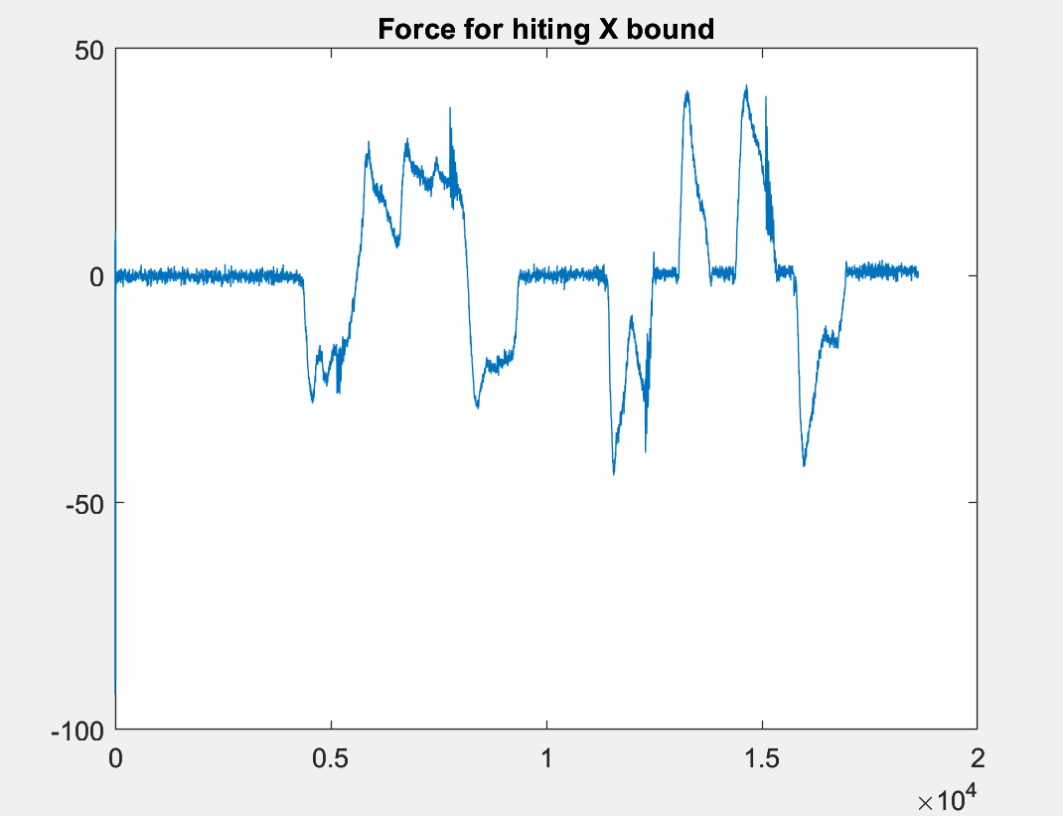
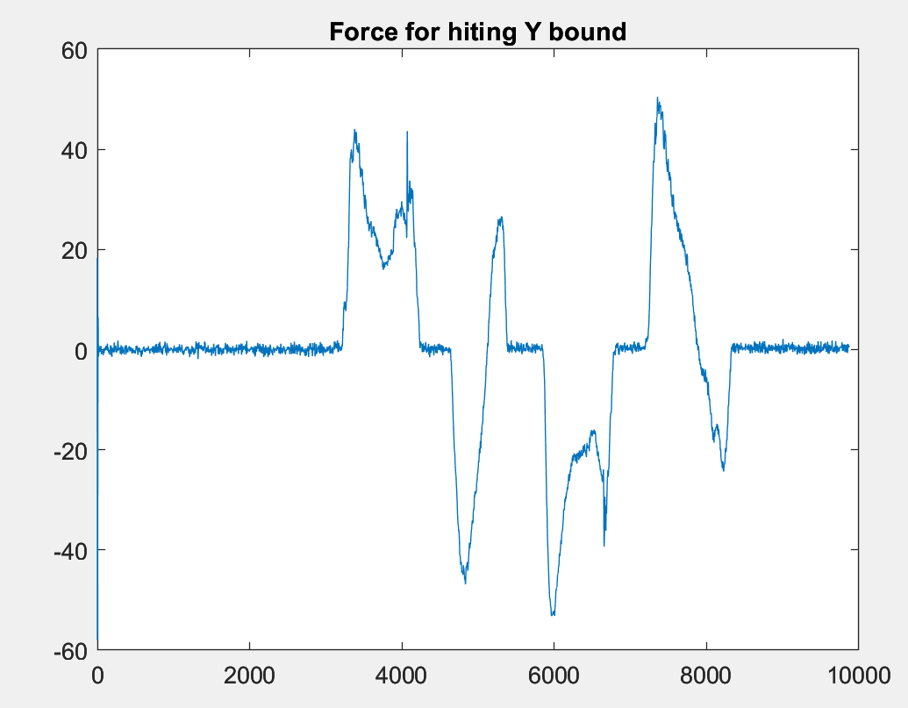
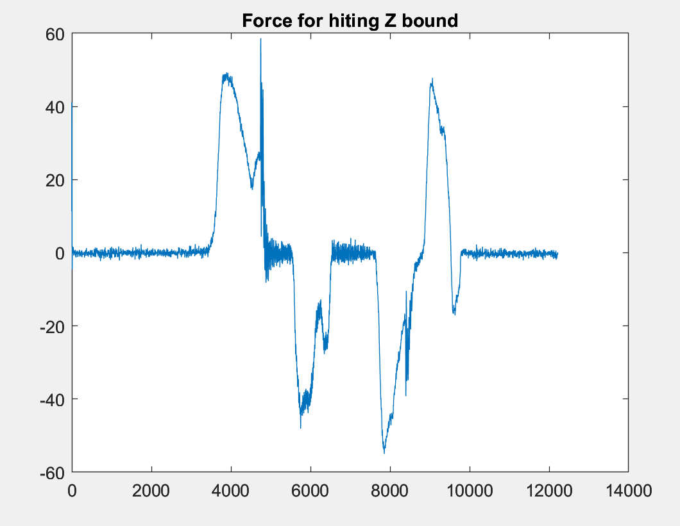
Potential Cause for Shaking: Software
Excluded:
Same thing does not happen on lower bound
Experiment: Do not take force input from the sensor, but spool a fake force that drive the arm: Shake still happens without reading the vibration
Force sensor reading has saturation: Zeros when less than 20 -> The vibrated reading is the result of the vibration, not the cause

Slide 9
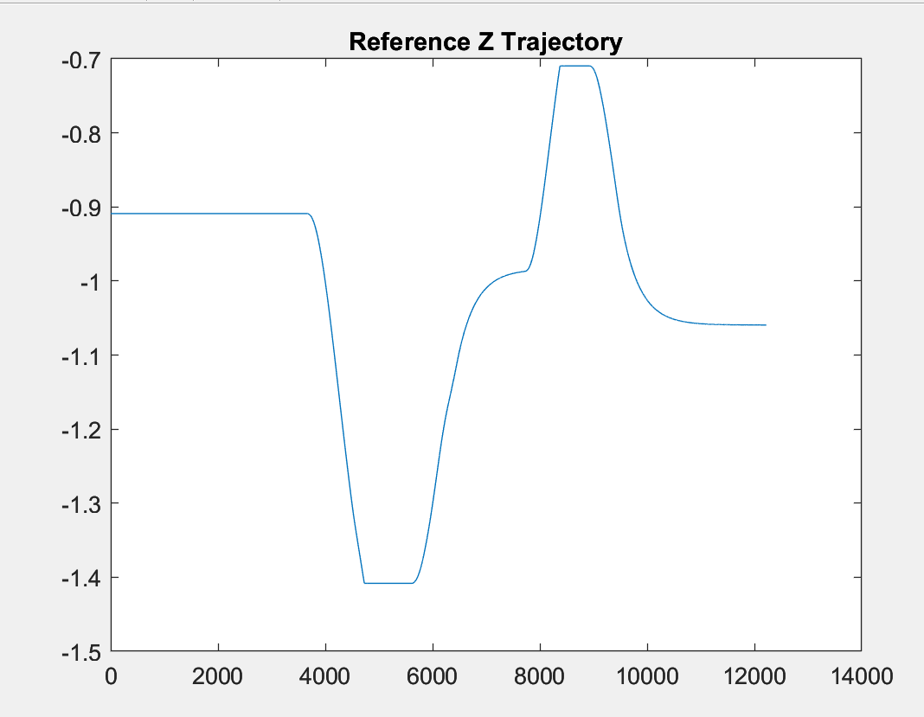
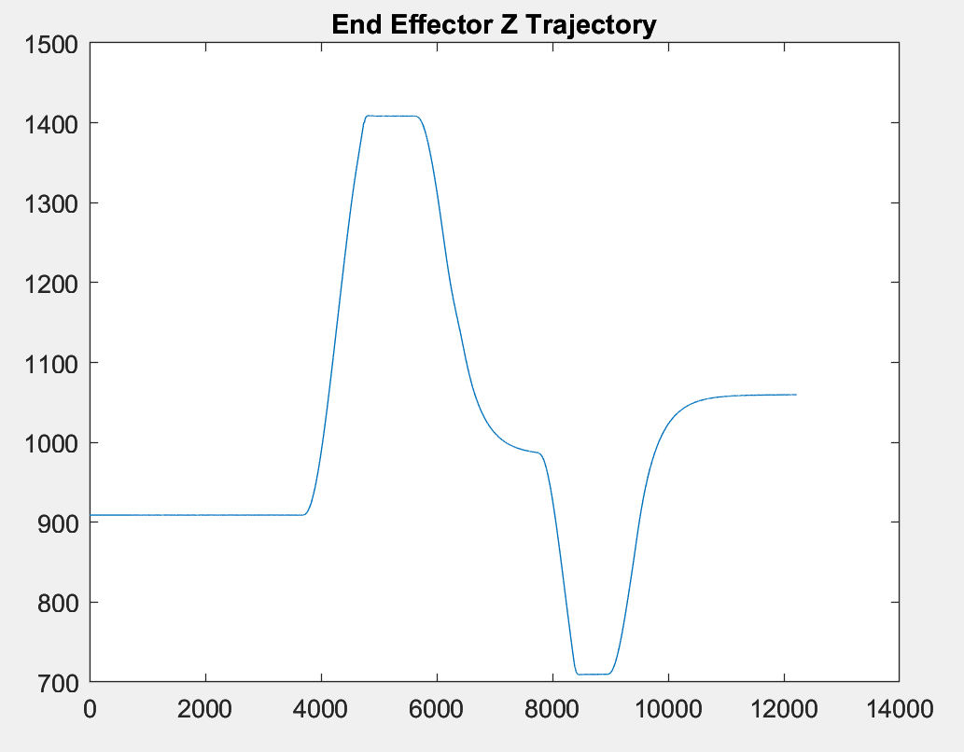
Potential Cause for Shaking: Software
Wrong reference trajectory being generated (GTFO issue):
Plot the reference Z trajectory :
Very smooth and continuous
Plot End Effector Z-position
Also smooth and correspond to reference
Excluded

Slide 10
Potential Cause for Shaking: Software
GTFO bound code issue:
Excluded: Only upper bounds on Z direction causes shaking

Slide 11
Potential Cause for Shaking (in beginning)
Hardware issue (the vibration is something we do not command the arm to do)
Motor/ Arm damaged
The speed when hits the bound is too high.
Software Issue: (the vibration happens because we let the arm to do like that)
Unstable control frequency at 500Hz
Force Sensor issue: reading vibrated forces which causes vibrational motion on the arm
Wrong reference trajectory being generated (GTFO issue)
GTFO hardbound issue (Did not cancel out the speed and position entirely)
None of these are the causes

Slide 12
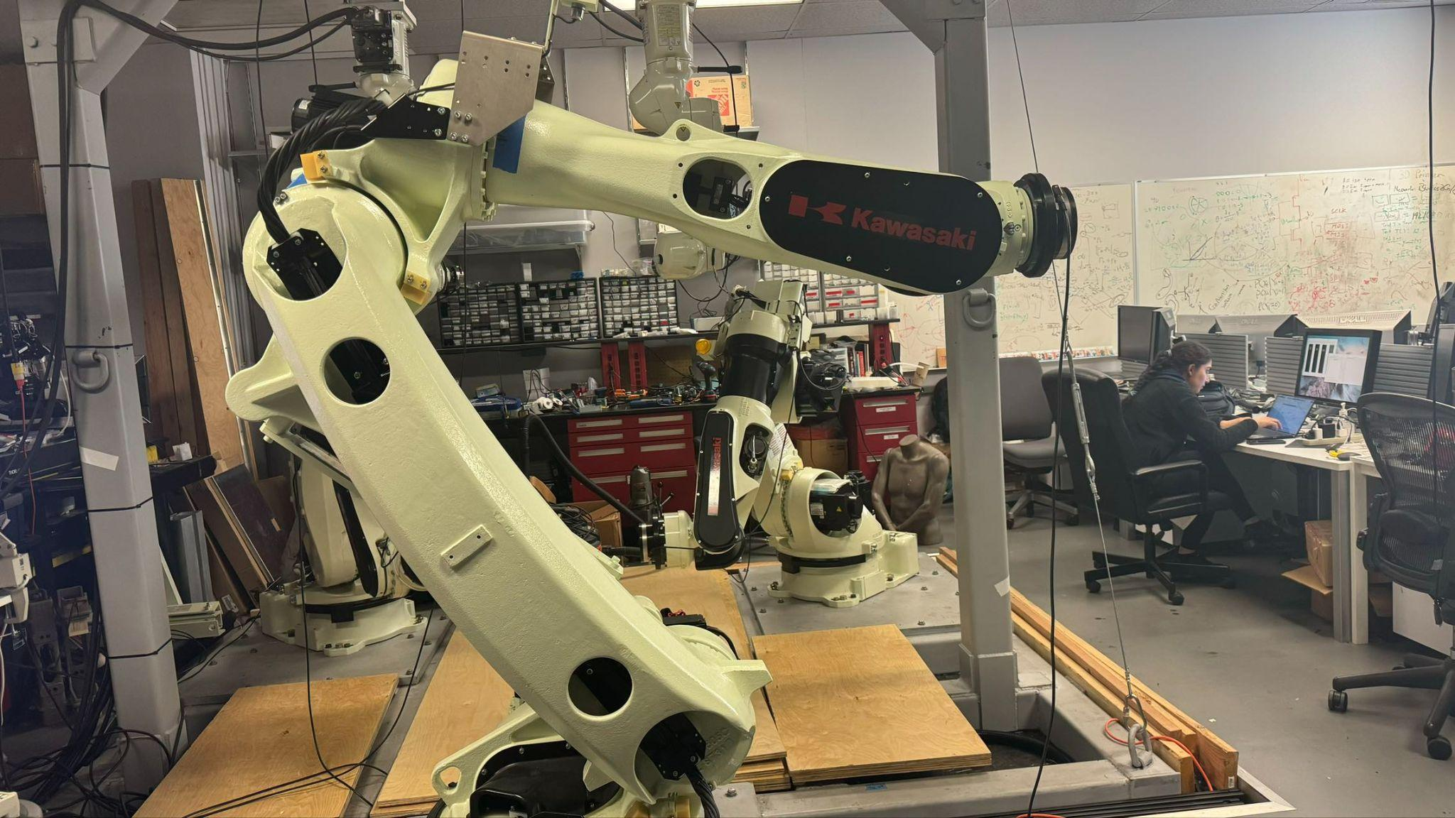
Potential Cause for Shaking:Afterward
Observation:
Shaking only happens at a certain level of height
without hitting any bounds it will start shaking
Only on the way going down
Singularity

Slide 13
Potential Cause for Shaking: Afterward
New experimental setup:
Move robot away from singularity: Turn joint 5 to be 90 degrees away from joint 4
Conduct same experiment: X bound, Y bound, Z bound
No shaking!
Conclusion on Problem 1: Robot IK gives joint reference that is not precise due to matrix near singularity, which casus a difference between desired position and real position.

Slide 14
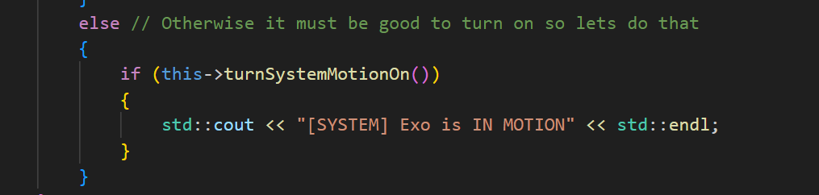
Potential Cause for Drifting:
All the drifting happens after “t” was pressed:
turnSystemMotionon is the “Suspect” After we comment this line, no drift

Slide 15
Potential Cause for Drifting:
turnSystemMotionon: Start the control loop
Read robostate -> feed into Admittance Controller -> Write those state (make it move)
Inside AdmittanceController:
Force reading is zero
Virtual Position never changed
However Virtual Robot Pose always change

Slide 16
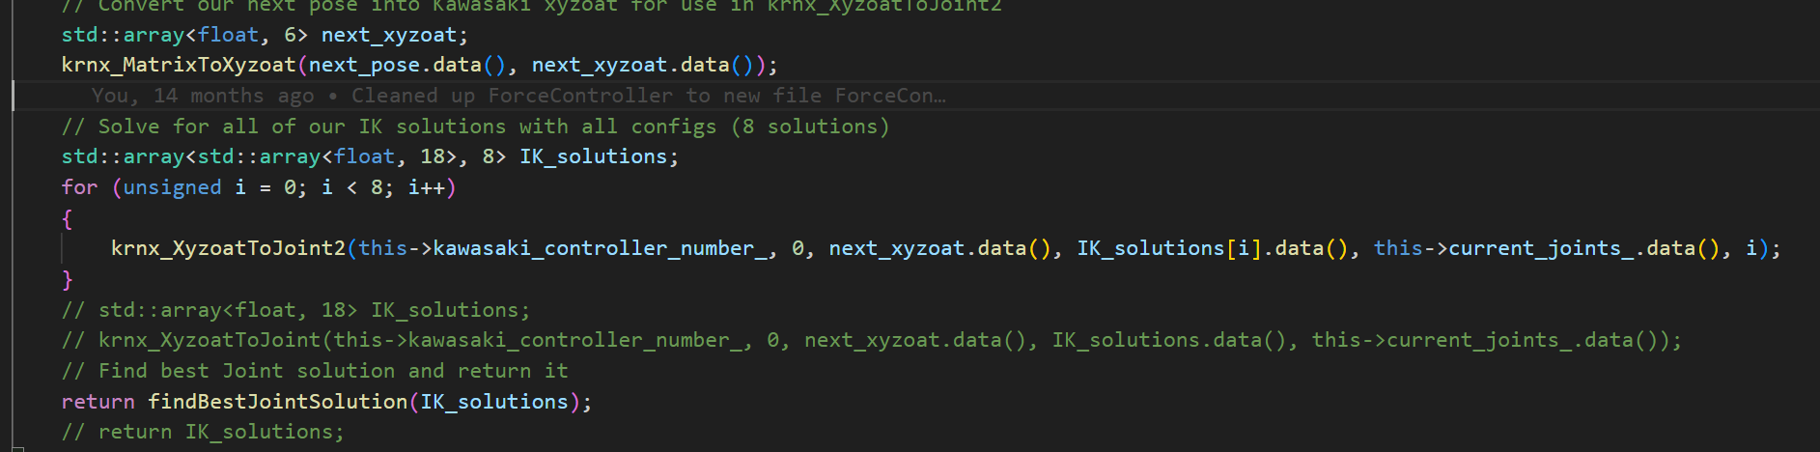
Potential Cause for Drifting:
Robot Pose: 3 by 4 transformation matrix that describe position and orientation of the robot
We are using 3D model, so only the 3 by 1 vector on 4th column was updated
Next post feed into IK solver to get joint reference position (Nothing wrong up to now)

Slide 17
Potential Cause for Drifting:
Problem:
IK gives returns 8 solution, but none of them coincide with our current joint configuration!
IK constantly gives different joint even though the virtual position does not change
Drifting also happens on other arms, except they are much smaller than bodysupport
The problem is actually in all arms!

Slide 18
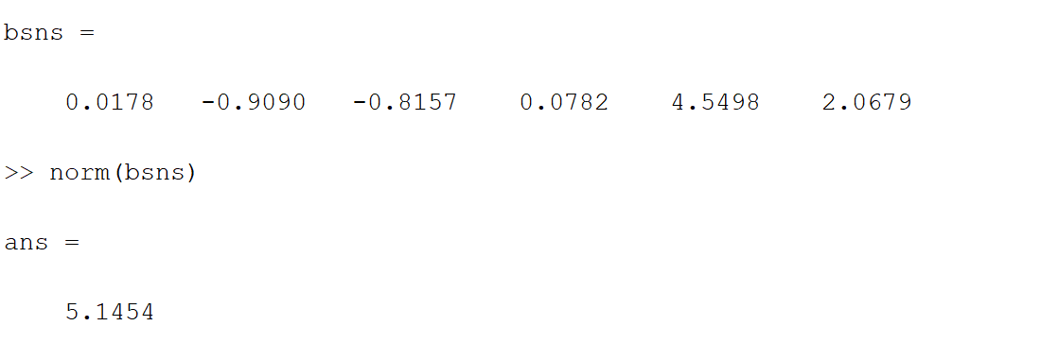
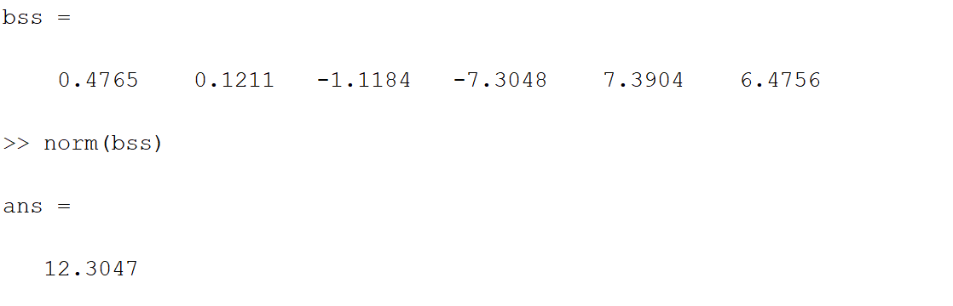
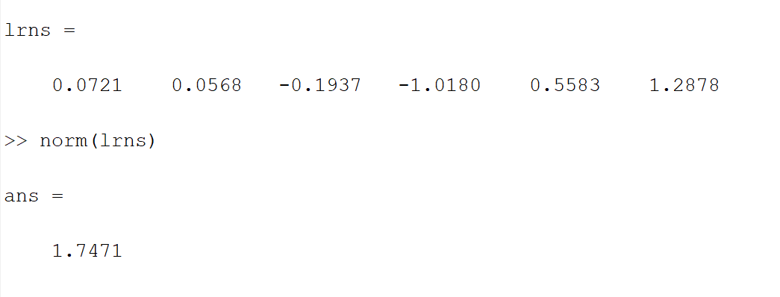
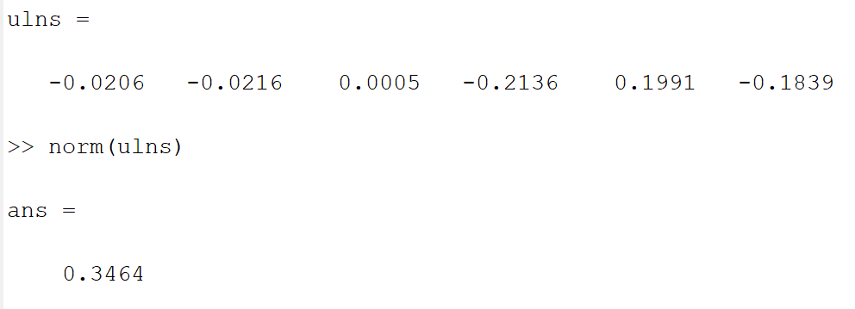
Potential Cause for Drifting:
Let it drift for 50s, and see the difference between initial and final position:
Body support drift at non-singular position Body support drift at Singular position
Lower Right Arm drift at non-singular position Upper Left Arm drift at non-singular position

Slide 19
Potential Cause for Drifting:
Solution to drift questions:
Enforce 6D motion on each arm.
Virtual position and orientation will not move without any FT inputs, which will act like a ground truth for robot post.
Even if the robot start drifting, the virtual orientation will correct it back and than solve the correct IK according to it.
The shaking surprisingly went away after switching to 6D motion!

Slide 20
Drifting Fix but No Explanation. Erik, help!
Like Xiaochen said, when we work in just 3D and assume orientation fixed, we get drift. The IK solver is producing different orientations even with no FT input. BAD.
It turns out that this is happening in all arms, just more pronounced on the BodySupport. Initially, we think that this might just be a hardware limitation. Since it is a much larger arm, inherently the IK solver will be less accurate, etc. But following Erik’s general wisdom, it is hard to think Kawasaki would produce such drifting hardware or produce a bad IK solver.
Find (first) solution in code: remove UpdatePose() entirely

Slide 21
Solutions
If we comment out updatePose(), there is no more drifting or shaking. Nice! Why?
Wait a second, updatePose() updates the AdmittanceController’s local current_joints and current_pose… how can we just comment it out? Is the virtual model being updated elsewhere?
See SetVirtualPositionToPhysical <- possibly weird

Slide 22
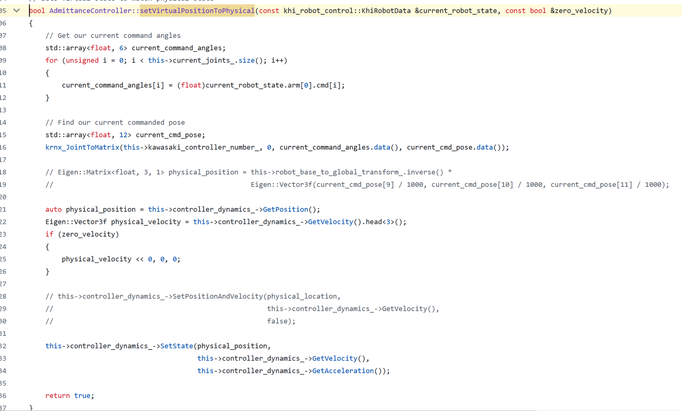

Slide 23
Solutions
If we comment out updatePose(), there is no more drifting or shaking. Nice! Wait why?
Wait a second, updatePose() updates the AdmittanceController’s local current_joints and current_pose… how can we just comment it out? Is the virtual model being updated elsewhere?
See SetVirtualPositionToPhysical <- possibly weird
If we change updatePose() to intake the robot_state’s cmd commands, and not the pos, we also get rid of drifting or shaking. Nice!
Here, possible explanation is that we are updating state with cmd, i.e. we virtual model assumes robot reaches cmd in a given timestamp (assumption of high performance controller which we would need for constrained admittance control)

Slide 24
Guesses
CMD and POS actually differ even when the robot is just powering on. Maybe we are not properly using the two in some places. Maybe the virtual model should always use CMD, since we are assuming we are working with a high performance controller that can properly track our references (see Jianwei paper)
I.e. always UpdatePose() with CMD
GTFO is doing its job, but we are unsure of where exactly we are storing the virtual model and modifying it. The Exo Overwatch thread also calls SetVirtualPositionToPhysical() right when ‘t’ is pressed, but the effects of this are uncertain
How can anything move when current_joints/pose are not updated?

